Slide 1
Database Management Systems New and Old Book Purchase System
By
2110030031- Sumeet Sharma
2110030190- K.Sai Vardhan Reddy
2110030252- Mohammed Afeef Sayeed
2110030109- D.Harsha Vardhan Reddy
Under the guidance of
(Mr. Sumit Harza)

Slide 2
Objective
The Main Objective of this project is to create an Online Book Shop That Allows user that allows to search and purchase a book online based category, author and subject.
(Based on Bookstore Management System)

Slide 3
DATA SET COLLECTIONS
User{u_ID,u_Name,u_Username,u_Password,u_gender,u_email,u_contact,u_city}
Contact{con_id, con_name, con_email, con_query}
Book{Book_ID, Book_Name, Book_desc, Book_Publisher, Book_Price, Book_NoPages, Book_Img}
Cart{Cart_ID,Book_ID,User_Name,Cost,Book_Name,Quantity}
CheckOut(Order_ID,Cart_ID,Order_Date,Total_Amount}

Slide 4
TOOLS SETUP
MYSQL
HTML
CSS
PYTHON

Slide 5
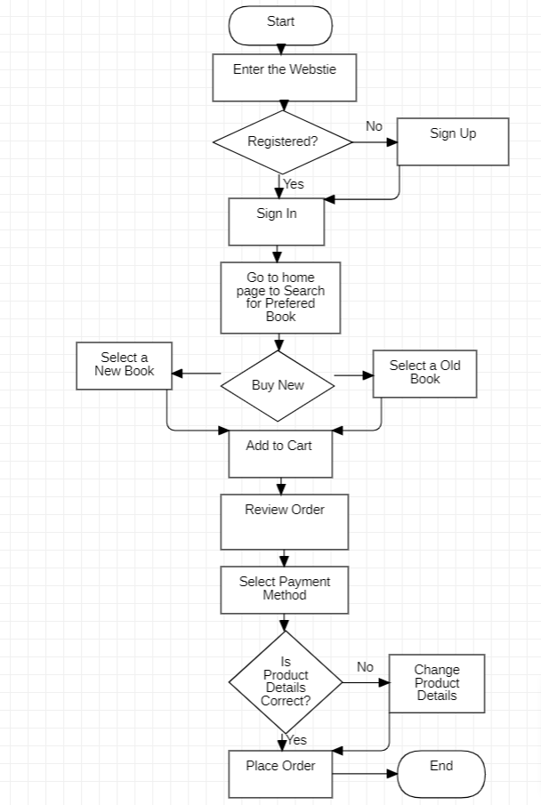
FLOW CHART

Slide 6
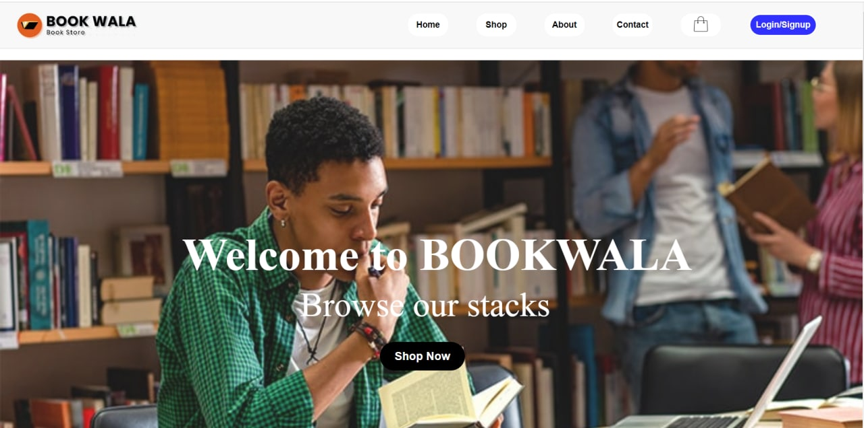
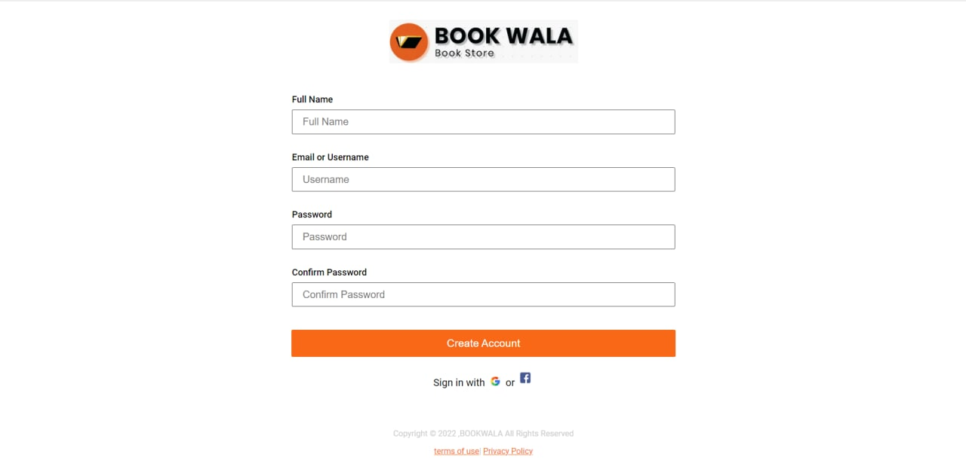

Slide 7
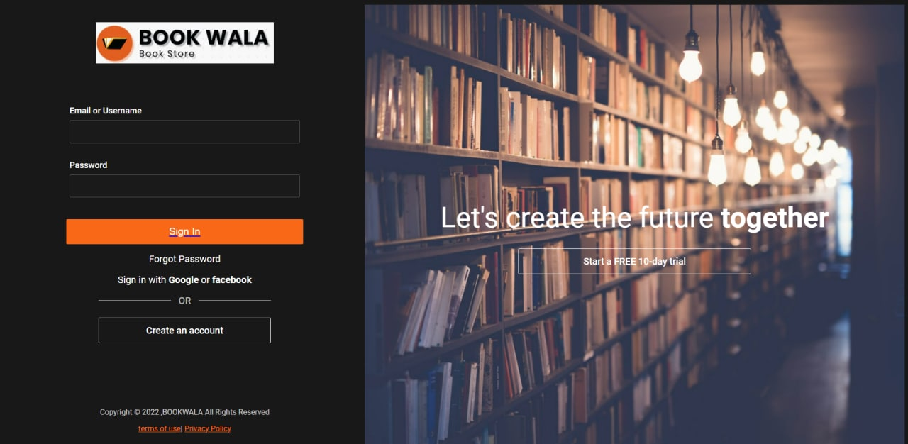
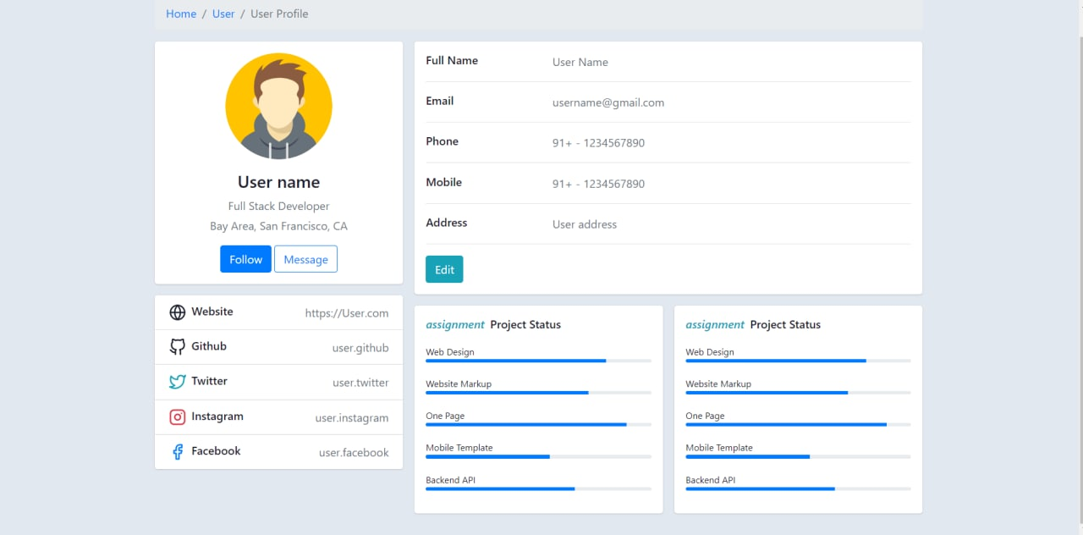

Slide 8
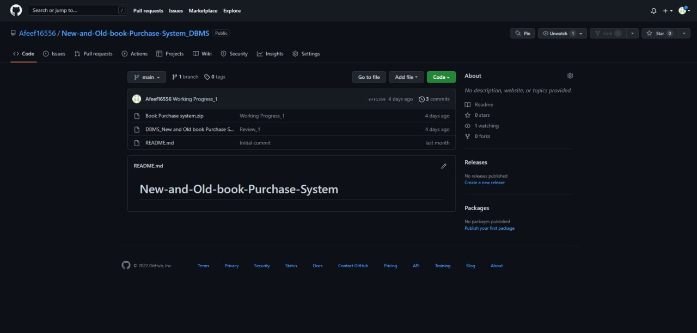
Github setup
https://github.com/Afeef16556/New-and-Old-book-Purchase-System_DBMS

Slide 9
Division of work among the group members
2110030031 - Web Designing , Coding.
2110030190 - Web Designing , Coding.
2110030109 - Data Base Creation , Documentation.
2110030252 - Data Base Creation , Documentation.

Slide 10
Thank You

